Slide 1


BuildFest 2.0
PS-21
Low power slam for planetary Exploration
Team Name
GURKIART SINGH (Team Lead) ▪ BHAWARDEEP SINGH ▪ DEV GROVER
Department of mechanical engineering
Guru Nanak Dev University

Slide 2
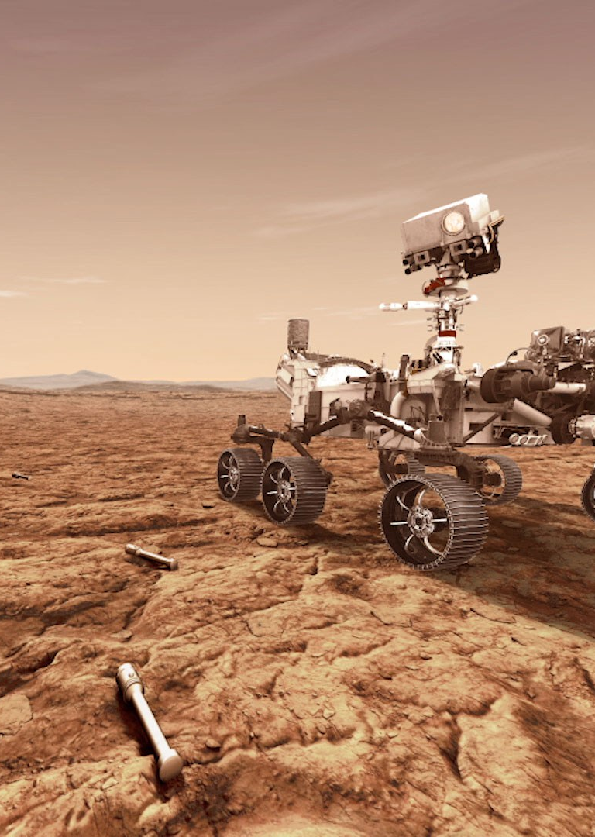

PROJECT BRIEF · 2026
PS-21
Low-Cost Autonomous Rover
Proof-of-Concept for Visual-Inertial SLAM and 2D Hazard Mapping under Space-Grade Compute Constraints.
VIO SLAM
≤150 MB RAM
ROS 2
Planetary Robotics Working Group · Internal Review
Team name: Ternary Tensors
Notes:
Open the deck and introduce PS-21 as a low-cost autonomous rover proof-of-concept.
Name the dual mission: monocular VIO SLAM plus a continuously updated 2D hazard grid.
Call out the organizing constraint — everything runs inside ≤150 MB of RAM on Pi 4-class hardware.
Frame the talk as a hardware + algorithmic pipeline review: chassis → compute → front-end → back-end → terrain.
Set the tone: cheap parts, space-grade discipline, real autonomy.

Slide 3
PS-21 · LOW-COST AUTONOMOUS ROVER
02 / 12
MISSION PROFILE
An untethered rover that maps terrain it cannot afford to forget.
PS-21 is a budget-friendly, untethered mobile rover built to validate autonomous planetary exploration on commodity hardware. It carries its own power, compute, and sensing — no tether, no offboard processing — and is designed to demonstrate that real Visual-Inertial Odometry and hazard mapping can run inside the kind of computational envelope a real mission would impose.
≤150 MB
Pi 4
RAM BUDGET
COMPUTE TARGET
The proof-of-concept targets two simultaneous deliverables: a real-time monocular VIO estimate that resolves scale ambiguity using inertial cues, and a continuously updated top-down 2D hazard grid that flags terrain too rough or steep to traverse. Together they form the minimum viable autonomy stack for a low-cost planetary scout.
VIO + 2D
4WD
CORE OUTPUTS
MOBILITY
PS-21 · MISSION PROFILE
02
Notes:
Open with why untethered matters — onboard power, compute, and sensing make this a real mission proxy.
Explain the dual-output philosophy: VIO pose estimate plus a live 2D hazard grid are inseparable deliverables.
Frame the 150 MB RAM ceiling as the organizing constraint — every design choice answers to it.
Walk the four right-side stats as the proof-of-concept's operating envelope.
Tee up the rest of the deck: hardware first, then algorithm, then output.

Slide 4
PS-21 · LOW-COST AUTONOMOUS ROVER
03 / 12
THE CHALLENGE
Real autonomy, simulated space-grade limits.
▦
✦
◉
Memory Ceiling
Compute Footprint
Monocular Scale Ambiguity
A hard ≤150 MB RAM cap on the host. Sliding-window optimization, keyframe marginalization, and Chow-Liu sparsification all exist to keep the factor graph inside this envelope — not as an optimization luxury.
Raspberry Pi 4-class CPU is the reference target. Front-end feature extraction and optical flow must run cheaply enough to leave headroom for back-end optimization and the hazard pipeline.
A single camera cannot recover metric scale. The 200 Hz IMU is not optional — it is the only way to resolve scale and keep VIO trajectories physically meaningful on rough terrain.
Every algorithmic choice is downstream of one number.
150 MB of RAM is not a target — it is the constraint that shapes the front-end, the back-end, and the terrain pipeline alike.
PS-21 · CONSTRAINTS
03
Notes:
Open with the constraint-first mindset — every design decision answers to a number, not a preference.
Walk the three pressure points in order: memory ceiling (RAM), compute footprint (CPU), and monocular scale ambiguity (sensor).
Stress that the 200 Hz IMU is mandatory, not optional — without it, monocular VIO has no metric scale.
Use the navy band as the takeaway: 150 MB is the constraint, not a target.
Bridge to the rest of the deck: each pipeline stage is shaped by these three limits.

Slide 5
01 / 02
Hardware Architecture
Chassis, actuation, and the onboard compute + sensing stack that PS-21 carries into the field.
Notes:
Transition into the hardware walk-through — chassis first, then the compute and sensing stack.

Slide 6
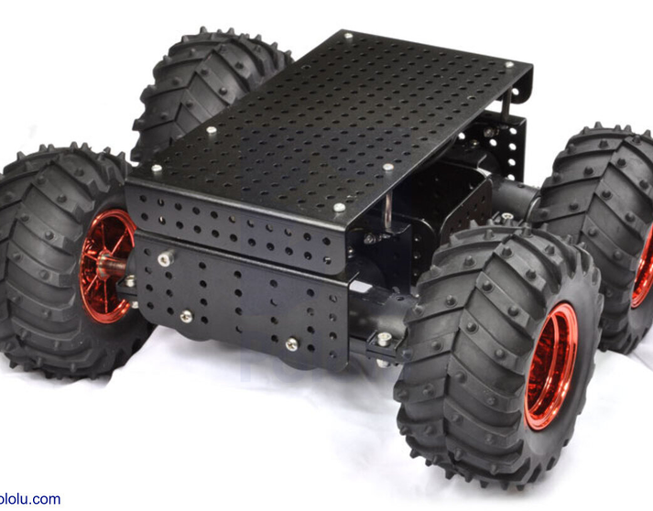
PS-21 · HARDWARE ARCHITECTURE
05 / 12
CHASSIS & ACTUATION
A rugged 4WD platform built around commodity drive components.
◔
4-Wheel Drive Chassis
Rugged skid-steer platform with four driven wheels, sized for indoor and outdoor prototype terrain. Geometry tuned for stable monocular capture while crossing small obstacles.
⚙
100 RPM Johnson Motors
Geared Johnson DC motors at each wheel. Torque and speed balanced for slow, controlled traversal — the regime where VIO feature tracks stay stable across frames.
✦
Dual-Channel Motor Driver (L293D)
L293D-class driver routes PWM from the Arduino Nano to the motor pairs. Direction and enable lines give skid-steer differential control with minimal wiring overhead.
⚡
Untethered Power
Onboard battery supply — no tether, no external rail. Power budget sized to keep compute, vision, and drive all running for a full mission-length traversal.
Reference: 4WD robotic chassis with knobby tires and perforated deck — PS-21 uses an analogous prototype platform.
05
PS-21 · HARDWARE
Notes:
- Skid-steer geometry keeps the build mechanically simple and lets the rover turn on the spot.
- Slow 100 RPM Johnson motors keep inter-frame displacement small so VIO feature tracks stay stable.
- L293D dual-channel driver trades efficiency for wiring simplicity — direction + enable lines cover skid-steer.
- Untethered power is non-negotiable: compute, vision, and drive all share one onboard battery budget.

Slide 7
PS-21 · HARDWARE ARCHITECTURE
06 / 12
COMPUTE & VISION STACK
Three devices, one onboard pipeline.
PS-21 splits perception, low-level control, and wireless bridging across three cheap, swappable modules — each chosen so the failure of one does not collapse the rest.
VISION + WIRELESS
LOW-LEVEL CONTROL
INERTIAL SENSING
◉
ESP32-CAM
▦
Arduino Nano
✦
MPU-6050
OV2640 monocular sensor · Wi-Fi bridge
Hardware slave · IMU reader · PWM driver
6-axis IMU · I2C · chassis-center mount
Dual-purpose module. The OV2640 sensor captures monocular frames for the VIO front-end, while the ESP32's Wi-Fi radio streams the video feed to the host laptop and receives movement commands — eliminating a separate wireless link.
Reads high-frequency IMU samples over I2C and drives motor PWM outputs. Programmed via the ESP32-CAM serial bridge as a workaround for the missing Mini-USB cable — a deliberate bootstrapping hack to keep the build moving.
A 6-axis MEMS IMU mounted flat at the exact geometric center of the chassis deck. Samples motion at 200 Hz, feeding the back-end with the inertial cues needed to resolve monocular scale ambiguity on rough terrain.
2 ROLES · 1 BOARD
200 HZ IMU READ
6-AXIS · 200 HZ
06
PS-21 · COMPUTE STACK
Notes:
- Three cheap, swappable boards: a single-board failure doesn't collapse the autonomy stack.
- ESP32-CAM pulls double duty — monocular vision for VIO plus the Wi-Fi command/video link, no extra radio.
- Nano is flashed over the ESP32-CAM serial bridge as a deliberate workaround for the missing Mini-USB cable.
- MPU-6050 is mounted flat at the chassis geometric center so inertial readings reflect true body motion.
- Role split: ESP32-CAM = vision + comms, Nano = low-level control + IMU read, MPU-6050 = inertial cues.

Slide 8
PS-21 · HARDWARE ARCHITECTURE
07 / 12
ODOMETRY & INERTIAL SENSING
Wheel encoders and a 200 Hz IMU back the visual estimate.
WHEEL ODOMETRY
INERTIAL SENSING
Wheel Encoders
MPU-6050 IMU
Custom encoders on the front two wheels pair Hall effect sensors with neodymium magnets to deliver reliable odometric pulses even when vision struggles — dust, low texture, or motion blur.
A 6-axis MEMS IMU is mounted flat at the exact geometric center of the chassis deck and sampled at 200 Hz by the Arduino Nano. High-frequency inertial cues feed the back-end to resolve the scale ambiguity inherent to monocular VIO.
● Sensing: Hall effect + neodymium magnets
● Mounting: front two wheels only
● Role: backup odometry when VIO degrades
● Axes: 6 (3 accel + 3 gyro)
● Sample rate: 200 Hz over I2C
● Mount: chassis-center, flat orientation
Odometry is the safety net — not the primary estimate.
Inertial cues are what make monocular SLAM metric, not just geometric.
PS-21 · ODOMETRY & IMU
07
Notes:
- Hall effect + neodymium magnets give reliable pulses even in dust, low texture, or motion blur.
- Only the front two wheels carry encoders — enough for skid-steer differential odometry at low cost.
- IMU sits flat at the chassis geometric center so inertial readings reflect true body motion, not deck flex.
- Role split: encoders are the safety net when VIO degrades; IMU is what makes monocular VIO metric.

Slide 9
02 / 02
Algorithmic Pipeline
Front-end perception, bounded-memory back-end optimization, and terrain reconstruction under the 150 MB ceiling.
Notes:
Pivot from hardware to the ROS 2 software pipeline — front-end first, then the bounded-memory back-end, then terrain reconstruction.

Slide 10
PS-21 · ALGORITHMIC PIPELINE
09 / 12
FRONT-END · VISION PREPROCESSING
From raw frame to trackable keypoints — cheaply.
The front-end runs entirely on the host (ROS 2). It converts each monocular frame to a robust, sparse set of tracked features while staying inside the CPU and RAM budget that the back-end depends on.
01
02
03
Grayscale + CLAHE
FAST Keypoint Detection
Pyramidal KLT Tracking
Frames are converted to grayscale and enhanced with Contrast Limited Adaptive Histogram Equalization. CLAHE tames the extreme lighting, deep shadows, and crater-rim contrast that would otherwise destroy feature stability across frames.
Lightweight FAST corner detector pulls sparse keypoints from the enhanced frame. FAST is chosen for its low CPU cost — leaving headroom for the optical-flow tracker and the back-end optimizer that share the same Pi 4-class host.
Keypoints are tracked across frames using pyramidal Lucas-Kanade optical flow. The pyramid lets tracks survive larger inter-frame displacements on rough terrain without forcing a full redetection on every frame.
→
→
OUTPUT: ENHANCED GRAYSCALE FRAME
OUTPUT: SPARSE KEYPOINT SET
OUTPUT: FEATURE TRACKS FOR VIO
PS-21 · FRONT-END
09
Notes:
- CLAHE before detection neutralizes crater-rim contrast and deep shadows that would wreck feature stability.
- FAST chosen over ORB/SIFT for its low CPU cost — frees headroom for tracker + back-end on Pi 4.
- Pyramidal KLT survives larger inter-frame displacements on rough terrain without full redetection.
- Front-end stays under the RAM ceiling by remaining sparse: only a bounded keypoint set lives in memory.
- Entire front-end runs on the host under ROS 2 — no offboard processing, no GPU acceleration.

Slide 11
PS-21 · ALGORITHMIC PIPELINE
10 / 12
BACK-END · BOUNDED-MEMORY OPTIMIZATION
A sliding-window factor graph that refuses to grow.
Sliding-Window Factor Graph
Chow-Liu Tree Sparsification
Historical pose optimization is capped by a sliding-window factor graph. Only a bounded set of recent keyframes and their constraints are kept live in the optimization; older keyframes are marginalized out. This guarantees the back-end's working set — and therefore its RAM footprint — cannot grow without bound over a long traversal.
Naive keyframe marginalization causes dense matrix fill-in: dropping one keyframe can blow up the constraint matrix and silently exceed the RAM budget. Chow-Liu tree factor sparsification approximates the marginalization with a sparse tree-structured replacement, preserving the most informative pairwise dependencies and discarding the rest.
Result: pose optimization stays strictly under the 150 MB RAM ceiling, regardless of mission length.
Result: marginalization stays sparse — no fill-in, no silent RAM blow-up.
150 MB
SLIDING
CHOW-LIU
RAM CEILING (HARD)
WINDOW POLICY
SPARSIFICATION METHOD
PS-21 · BACK-END
10
Notes:
- Sliding window is non-negotiable: without it, the factor graph grows unbounded and 150 MB evaporates within minutes.
- Fill-in is the silent killer — dropping a keyframe naively makes the constraint matrix dense and blows the budget.
- Chow-Liu tree sparsification approximates the marginalization with a sparse tree, preserving the most informative pairwise dependencies.
- Takeaway: bounded memory is a property of the algorithm design, not a runtime hope or a tuning knob.

Slide 12
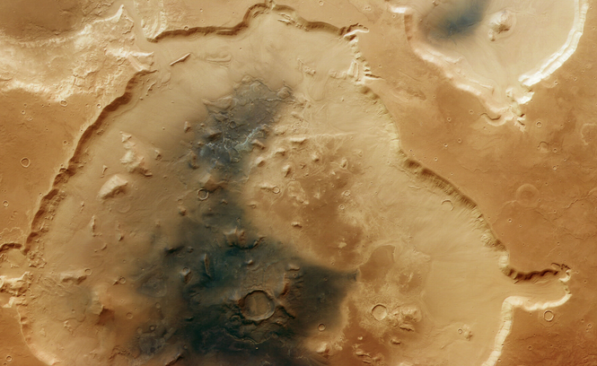
PS-21 · ALGORITHMIC PIPELINE
11 / 12
TERRAIN RECONSTRUCTION & HAZARD GRID
Sparse features become a top-down map of where not to drive.
STEP 01
2D Delaunay Triangulation
Sparse feature points are synthesized into a 2D Delaunay triangulation. The triangulation is the geometric scaffold that turns isolated point detections into a continuous, locally-connected terrain mesh.
STEP 02
ZNCC Photometric Filtering
Triangle faces are filtered using Zero-mean Normalized Cross-Correlation photometric consistency. ZNCC rejects shadow edges, dust artifacts, and lighting-induced false features before they pollute the hazard grid.
STEP 03
Top-Down Hazard Grid
Surviving triangles are projected into a top-down 2D hazard grid. Each cell tracks three quantities: step height (h), slope (α), and roughness (r) — the three signals a planner needs to decide where the rover can safely go next.
Reference: aerial view of cratered planetary terrain — analogous to the top-down hazard grid PS-21 produces.
H.STEPHEIGHT
Α · SLOPE
R · ROUGHNESS
11
PS-21 · TERRAIN
Notes:
- Delaunay before gridding because raw point clouds lack the local connectivity a hazard map needs.
- ZNCC protects against shadow edges, dust artifacts, and lighting-induced false features that would otherwise pollute the grid.
- Three hazard signals per cell — step height (h), slope (α), roughness (r) — cover the planning-relevant failure modes.
- The grid feeds downstream path planning, giving the planner a continuous "where not to drive" mask.

Slide 13
PS-21 · LOW-COST AUTONOMOUS ROVER
12 / 12
SUMMARY
A bounded-memory autonomy stack, built from cheap parts.
WHAT PS-21 PROVES
✓
▦
◫
VIO at the Edge
Hazard Mapping in Real Time
Built from Commodity Parts
Monocular VIO with inertial scale resolution can run on Pi 4-class hardware inside 150 MB of RAM — no GPU, no offboard compute, no tether.
Sparse features → Delaunay → ZNCC filter → 2D hazard grid produces a continuously updated top-down map of step height, slope, and roughness.
ESP32-CAM, Arduino Nano, MPU-6050, L293D, Johnson motors — every component is cheap and swappable, by design.
NEXT STEPS
01
02
03
04
Field-test VIO drift on extended outdoor traversals.
Benchmark RAM footprint under sustained 30+ minute runs.
Integrate hazard grid with a downstream path planner.
Harden ESP32-CAM Wi-Fi link against dropouts.
PS-21 · SUMMARY & NEXT STEPS
12
Notes:
- Restate the three things PS-21 proves: VIO at the edge, hazard mapping in real time, commodity-parts construction.
- Walk the four next steps in order — drift testing, RAM benchmarking, planner integration, Wi-Fi hardening.
- Close by inviting questions on hardware, algorithm, or integration — flag that these are the three areas most likely to need follow-up.
- Emphasize that next steps are deliberately scoped to validate the proof-of-concept, not extend the scope.

Slide 14


